Slide 1


Slide 2


Slide 3


Slide 4


Slide 5


Slide 6


Slide 7
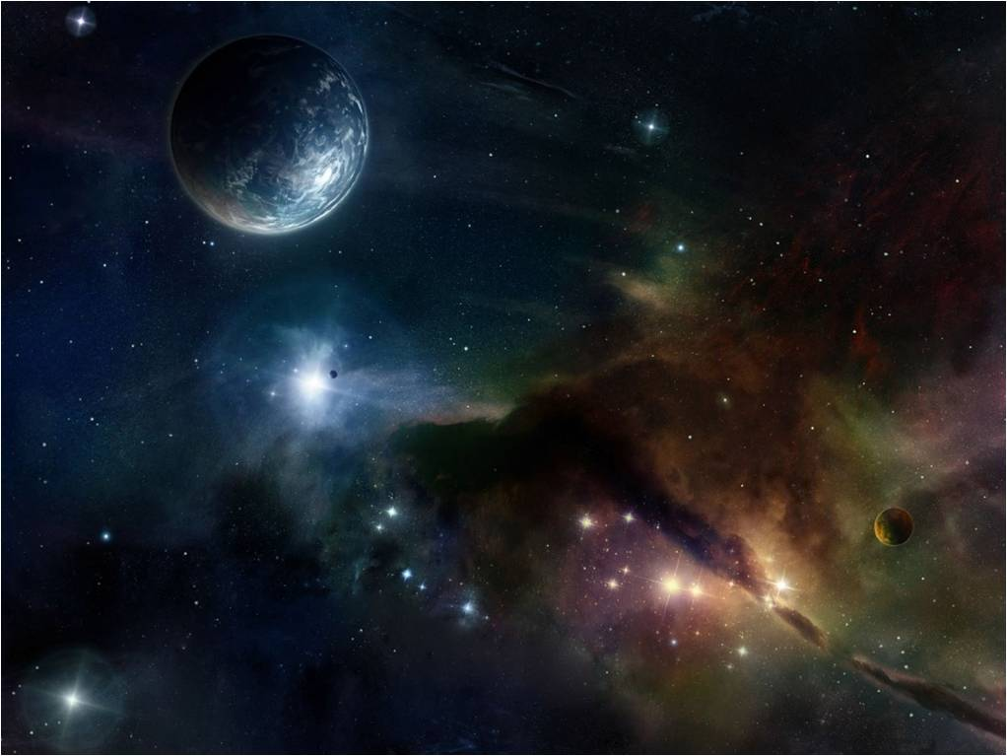

Slide 8


Slide 9


Slide 10


Slide 11


Slide 12
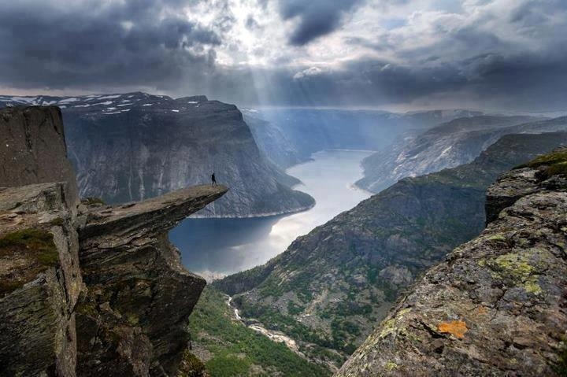

Slide 13


Slide 14


Slide 15


Slide 16


Slide 17


Slide 18
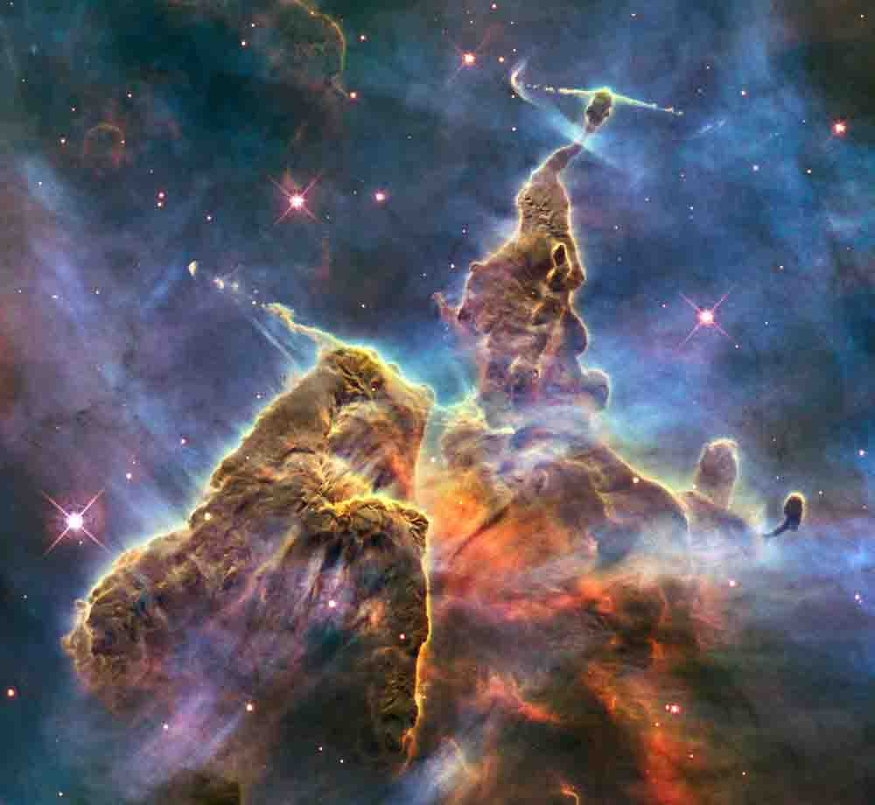

Slide 19


Slide 20
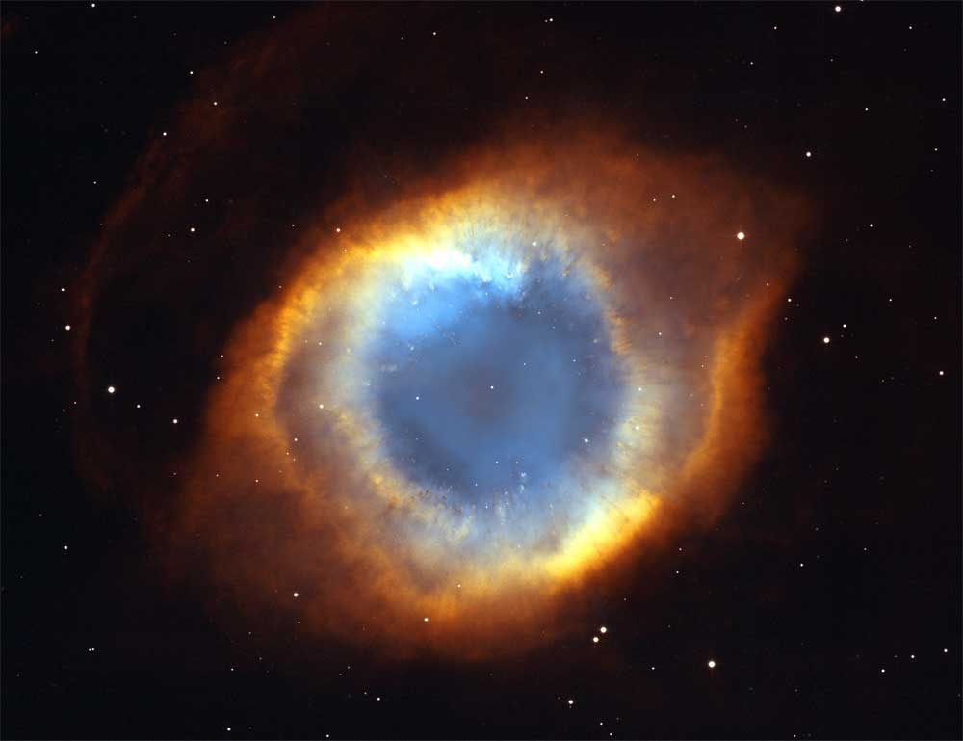

Slide 21


Slide 22


Slide 23
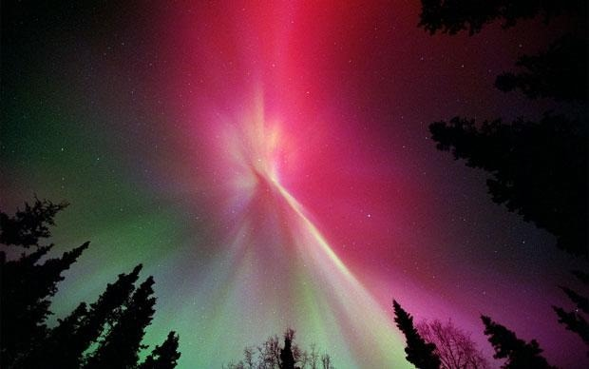

Slide 24


Slide 25


Slide 26


Slide 27


Slide 28


Slide 29


Slide 30


Slide 31


Slide 32


Slide 33


Slide 34


Slide 35



Slide 36
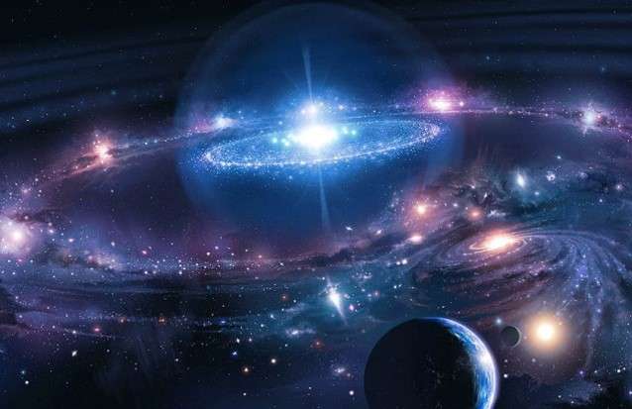

Slide 37


Slide 38
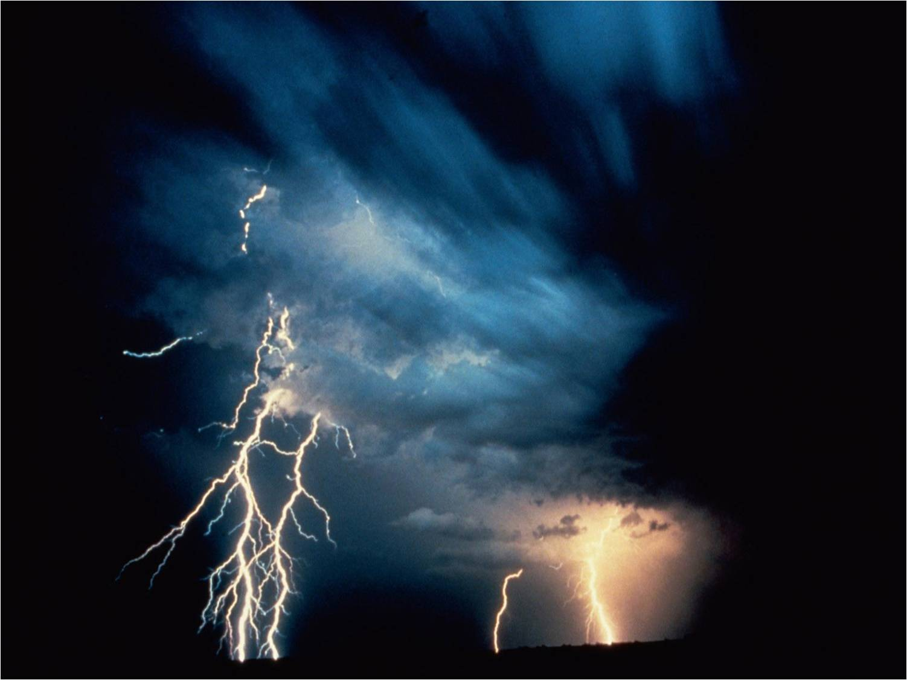

Slide 39


Slide 40


Slide 41


Slide 42


Slide 43


Slide 44


Slide 45


Slide 47

The Ten Most Misunderstood Words in the Bible
Everlasting

Slide 48
Misunderstanding
Everlasting means -
“ever-lasting”

Slide 49

Misunderstanding

Slide 50

Misunderstanding
Everlasting life can be lost?

Slide 51
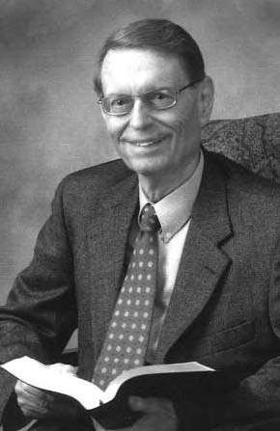
Misunderstanding
“If everlasting life could be lost, then it has the wrong name.”
Dr. Charles Ryrie

Slide 52
Everlasting / Eternal
New King James Version
“everlasting” – 438x’s
Hebrew - “`owlam” – “everlasting”, “eternal”, “perpetual”, or “forever”.

Slide 53
Everlasting / Eternal
New King James Version
Greek - “aionios” – 72x’s
“everlasting”, or “eternal”
“aion” – age

Slide 54
Everlasting / Eternal
New King James Version
“everlasting” – 103x’s
OT – 78x’s / NT – 25x’s
“eternal” – 72x’s
OT – 3x’s / NT – 48x’s

Slide 55
Everlasting / Eternal
New King James Version
“forever” – 394x’s
OT – 339x’s / NT – 55x’s

Slide 56
Everlasting / Eternal
“everlasting”, “eternal” forever” are “Adjectives”
An “adjective” is word that modifies or describes an noun, it gives additional detail.

Slide 57
Everlasting / Eternal
New King James Version - OT
“everlasting” covenant, possession, God, hills, ordinance, statue, priesthood, arms, righteousness, kingdom, salvation, love joy, name, light, confusion, reproach, contempt, life.

Slide 58
Everlasting / Eternal
New King James Version - NT
“everlasting”, “eternal” – life,
fire, punishment, destruction, home, God, Spirit, consolation, power, kingdom, inheritance, covenant, salvation, purpose, chains, gospel, glory.

Slide 59
Everlasting / Eternal Life
New King James Version - NT
“everlasting life” – 13x’s
“eternal life” – 32x’s
“life eternal” – 4x’s [KJV]
“live forever” – 2x’s
“…He who eats this bread will live forever.” (John 6:58)

Slide 60
Everlasting / Eternal Life
Low Level of Importance
The concept of everlasting life is understood is light of salvation, instead of the other way around.

Slide 61
Everlasting / Eternal Life
Low Level of Importance
Many church goers have little or no awareness of the expression “everlasting life”.
Are you Saved?

Slide 62
Everlasting / Eternal Life
Low Level of Importance
Many church goers have little or no awareness of the expression “everlasting life”.
Do you have everlasting life?

Slide 63
Everlasting / Eternal Life
High Level of Importance
Jesus spoke of everlasting life frequently and rarely spoke of salvation.
Jesus spoke of eternal life repeatedly throughout the Gospel of John

Slide 64
Everlasting / Eternal Life
High Level of Importance
Jesus made it clear that the person who simply believes in Him has, present tense, everlasting life that can never be lost.

Slide 65
Everlasting / Eternal Life
High Level of Importance
When evangelizing we should do what Jesus did -- use the language that Jesus used, because it conveys the message of life clearly and succinctly!

Slide 66
Everlasting / Eternal Life
High Level of Importance
The Gospel of John is the Gospel of Life (46x’s), written solely to tell an unbeliever how to have “everlasting life” (20:30-31)

Slide 67

Everlasting / Eternal Life
When a person possesses everlasting life he is then saved from the everlasting fire, from everlasting punishment and destruction, the second death.

Slide 68
Everlasting / Eternal Life
Salvation vs. Everlasting Life
Typically people talk about the loss of salvation as opposed to the lose of eternal life, they’ll say, “Oh, that’s the same thing”.

Slide 69
Everlasting / Eternal Life
Jesus said, “Whoever drinks of this water will thirst again, but whoever drinks of the water that I shall give him will never thirst. But the water that I shall give him will become in him a fountain of water springing up into everlasting life.” (Jn. 4:13-14)

Slide 70

Everlasting / Eternal Life
This means that the one who believes in Him will never lack everlasting life.

Slide 71
Everlasting / Eternal Life
Jesus said, “I am the bread of life. He who comes to Me shall never hunger, and he who believes in Me shall never thirst.” (John 6:35)

Slide 72
Everlasting / Eternal Life
“Most assuredly, I say to you, he who hears My word and believes in Him who sent Me has [present tense] everlasting life, and [future tense] shall not come into judgment, but [past tense] has passed from death into life.” (John5:24)

Slide 73
Everlasting / Eternal Life
Jesus said, “Most assuredly, I say to you, he who believes in Me has [present tense] everlasting life.” (John 6:47)

Slide 74
Everlasting / Eternal Life
“I am the resurrection and the life. He who believes in Me, though he may [physically] die, he shall live. And whoever lives and believes in Me [spiritually] shall never die.” (John 11:25-26)

Slide 75
Everlasting / Eternal Life
Jesus is affirming “once saved, always saved”. Once a person has everlasting life, he will never ever lose that life.
A life that will never end.
It will never be taken away.
It can’t be given back.

Slide 76
Everlasting / Eternal Life
Jesus is affirming “once saved, always saved”. Once a person has everlasting life, he will never ever lose that life.
If anyone who did believe in Him and has eternal life and then lost it, this would make Jesus a liar.

Slide 77
Everlasting / Eternal Life
“He who believes in the Son of God has the witness in himself; he who does not believe God has made Him a liar, because he has not believed the testimony that God has given of His Son.” (1 John 5:10)

Slide 78
Everlasting / Eternal Life
“And this is the testimony: that God has given us eternal life, and this life is in His Son.” (1 John 5:11)

Slide 79

Everlasting / Eternal Life
A person can no more lose everlasting life now than he would be able to lose everlasting life once he is in heaven / Kingdom.

Slide 80
Everlasting / Eternal Life
In order to believe in Jesus for everlasting life a person must believe that the life that He promises saves him once and forever, that is “once saved, always saved.”

Slide 81
Everlasting / Eternal Life
“But if a person has never believed that simply by faith in Jesus his eternal destiny is secure and cannot be lost or revoked or returned for any reason, then he clearly has not yet believed the truth of John 3:16.” [Wilkin, p. 26]

Slide 82
Everlasting / Eternal Life
More Than Unending Life
Quantitative Aspect
Its Length – never ending
Qualitative Aspect
Its Depth – varying degrees

Slide 83
Everlasting / Eternal Life
More Than Unending Life
Quantitative Aspect
Its Length – never ending
It is received as a gift by
“faith alone in Christ alone”.

Slide 84
Everlasting / Eternal Life
More Than Unending Life
Quantitative Aspect
Its Length – never ending
Once received, it becomes a present possession forever.

Slide 85
Everlasting / Eternal Life
More Than Unending Life
It is a future possession obtained by enduring in good works.
Qualitative Aspect
Its Depth – varying degrees

Slide 86
Everlasting / Eternal Life
More Than Unending Life
The future tense of eternal life emphasizes its potential fullness
Qualitative Aspect
Its Depth – varying degrees

Slide 87
Everlasting / Eternal Life
The Abundant Life
“If anyone enters by Me, he will be saved, and will go in and out and find pasture… I have come that they may have life, and that they may have it more abundantly.” (John 10:9a-10)

Slide 88
Everlasting / Eternal Life
Quantitative and Qualitative Aspect
“When we read of the present possession of eternal life the emphasis is on its eternality, its permanent duration. Though the idea of its potential fullness is surely in the background.” [Wilkin, p. 28]

Slide 89
Everlasting / Eternal Life
Qualitative Aspect
“Assuredly, I say to you, there is no one who has left house or brothers or sisters or father or mother or wife or children or lands, for My sake and the gospel's, who shall not receive a hundredfold now in this time --

Slide 90
Everlasting / Eternal Life
Qualitative Aspect
“…houses and brothers and sisters and mothers and children and lands, with persecutions -- and in the age to come, eternal life.” (Mark 10:29-31)

Slide 91
Everlasting / Eternal Life
Qualitative Aspect
“For he who sows to his flesh will of the flesh reap corruption, but he who sows to the Spirit will of the Spirit reap everlasting life.” (Galatians 6:8)

Slide 92
Everlasting / Eternal Life
Qualitative Aspect
“…pursue righteousness, godliness, faith, love, patience, gentleness. Fight the good fight of faith, lay hold on eternal life.” (1 Timothy 6:11-12)

Slide 93
Everlasting / Eternal Life
Qualitative Aspect
“Let them do good, that they be rich in good works, ready to give, willing to share, storing up for themselves a good foundation for the time to come, that they may lay hold on eternal life.” (1 Timothy 6:18-19)

Slide 94
Everlasting / Eternal Life
Whenever the Bible speaks of the free gift of everlasting life, received by faith alone, it always uses the present tense, and when it speaks of the potential fullness of eternal life it uses the future tense.

Slide 95
Everlasting / Eternal Life
The Fullness of Life
The fullness of our eternal life will be determined by what we do with the few decades that God gives us in this life. So it is important that we endure in doing good until the end.

Slide 96
Everlasting / Eternal Life
The Fullness of Life
“The one who reaps a fuller experience of everlasting life will glorify Christ more and reap more joy as a result.” [Wilkin, p. 29]

Slide 97
Everlasting / Eternal Life
“His lord said to him, ‘Well done, good and faithful servant; you were faithful over a few things, I will make you ruler over many things. Enter into the joy of your lord.” (Matthew 25:21)

Slide 98
Everlasting / Eternal Life
The Fullness of Life
The one who squanders this life will not have the fullness of everlasting life that he could have had forever.

Slide 99
Everlasting / Eternal Life
“The lord said to the lazy and wicked servant, ‘For to everyone who has, more will be given, and he will have abundance; but from him who does not have, even what he has will be taken away.” (Matthew 25:29)

Slide 100
Everlasting / Eternal Life
The Loss of the Fullness of Life
The fullness of everlasting life, its future qualitative aspect can be lost, but “everlasting life” itself can never be lost.

Slide 101
Everlasting / Eternal Life
The Loss of Service
“But I discipline my body and bring it into subjection, lest, when I have preached to others, I myself should become disqualified.”
(1 Corinthians 9:27)

Slide 102
Everlasting / Eternal Life
The Gain of Service
The more faithful we are in our service for Christ now, the greater our service for Jesus will be in the life to come.

Slide 103
Everlasting / Eternal Life
Ranks in the Kingdom
In the kingdom, “many that are first shall be last; and the last shall be first.” (Matthew 19:30)

Slide 104
Everlasting / Eternal Life
Ranks in the Kingdom
“…he who overcomes, and keeps My works until the end, to him I will give power over the nations.” (Revelation 2:26)

Slide 105
Everlasting / Eternal Life
Ranks in the Kingdom
“…If we endure, we shall also reign with Him.” (2 Timothy 2:12)
Jesus is the “King of kings and Lord of lords” (Revelation 19:16)

Slide 106
Everlasting / Eternal Life
The Quality of Eternal Life
While all believers will be in the kingdom forever, the quality of each one’s life will vary depending on the deeds done in the body (2 Corinthians 5:1-11)

Slide 107
Everlasting / Eternal Life
Conclusion
The present tense of everlasting life deals with its quantity, its length.
It is a gift received by faith alone in Christ alone, and can never be lost.

Slide 108
Everlasting / Eternal Life
Conclusion
The future tense of everlasting life deals with its quality, its depth.
It is obtained by enduring in good works, and it can be lost.

